Slide 1


Toy Car Workshop
By Elias Black

Slide 2


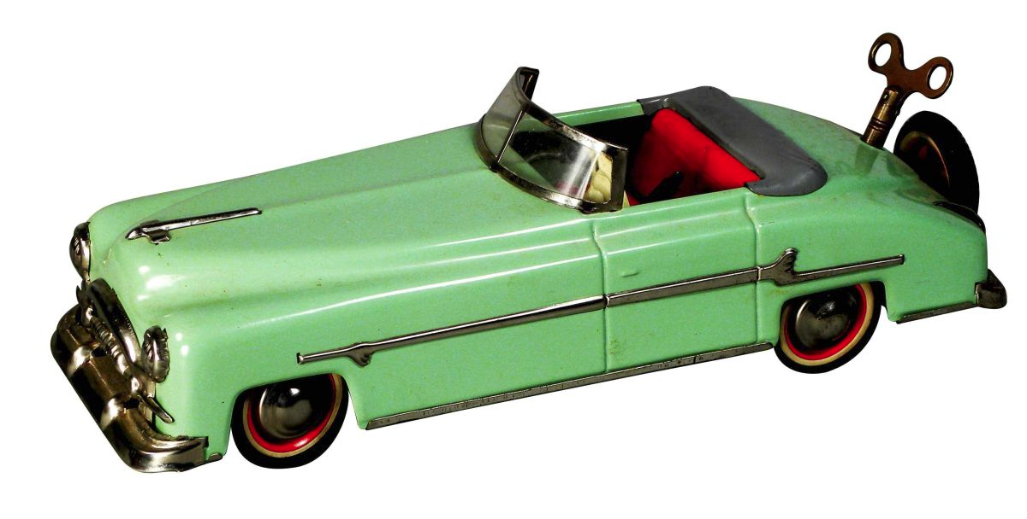

Toy Cars and Gear Ratios

Slide 3
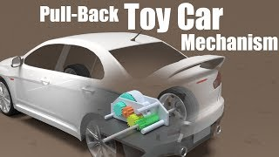

How do Wind Up Toy Cars Work?

Slide 4


How do Gears work?

Slide 5
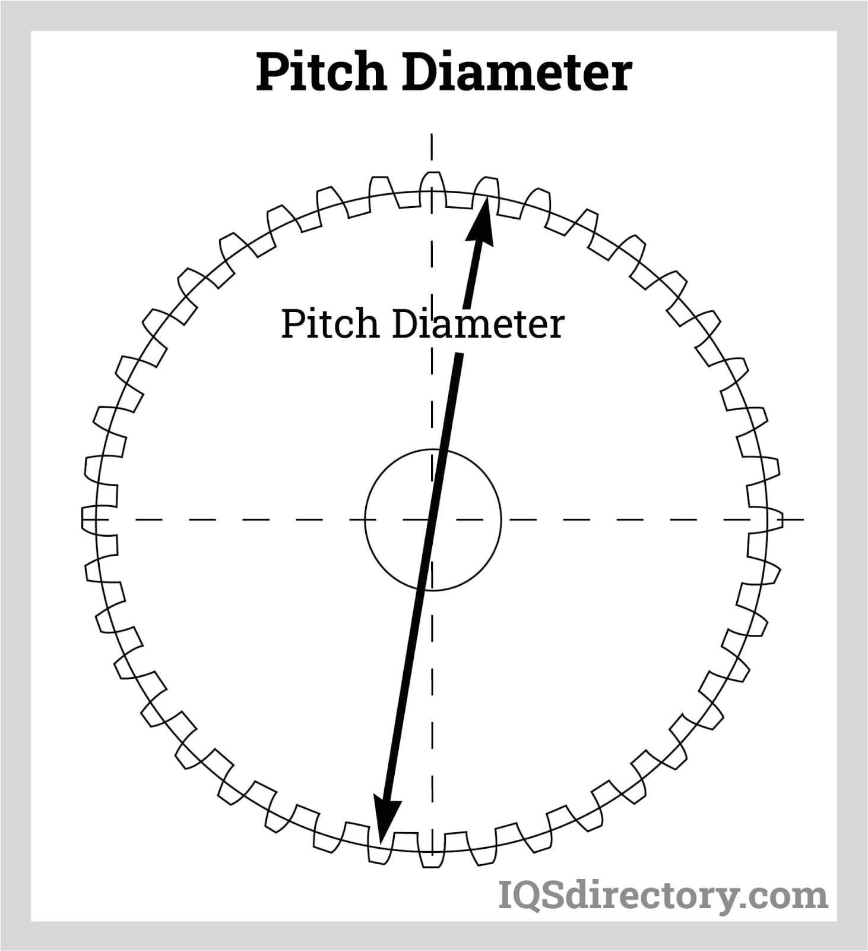
The basics:
Gear Pitch Diameter/Modulus
Two terms, Imperial and Metric
Ratio of the pitch diameter to the number of teeth
How gears mesh correctly

Slide 6
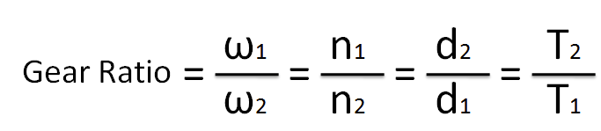
The basics:
Gear Speed
n1 and n2 represent the number of teeth of the gears
w1 and w2 represent the angular velocities of the gears

Slide 7
The basics:
Gear Torque
d1 and d2 represent the diameters of the gears pitch circles
T1 and T2 represent the torque of the gears

Slide 8
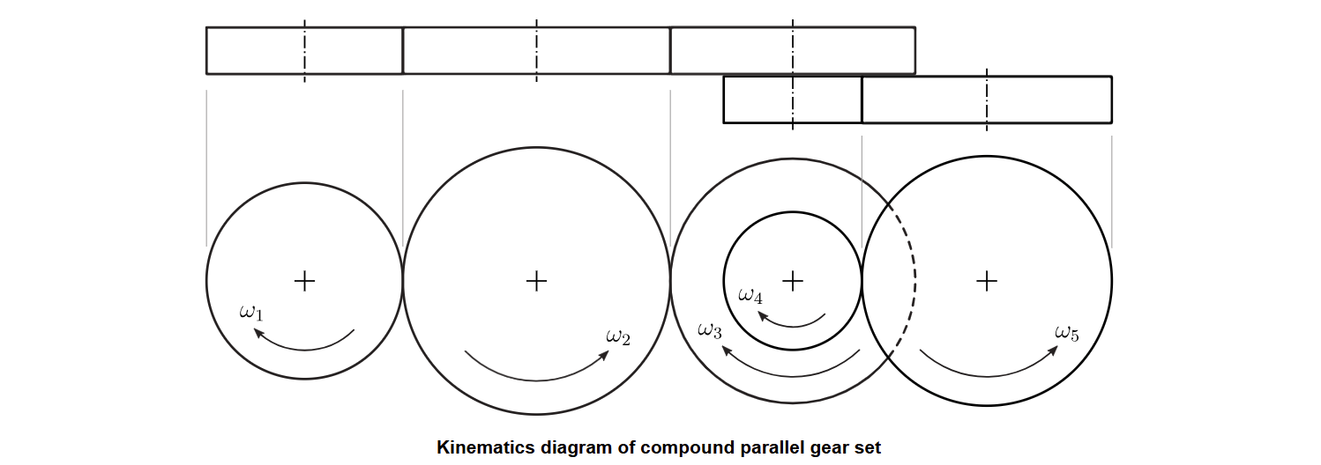
The basics:
Manipulating Gear Angular Velocities to form Gear Chains

Slide 9
How do Gears really work?

Slide 10
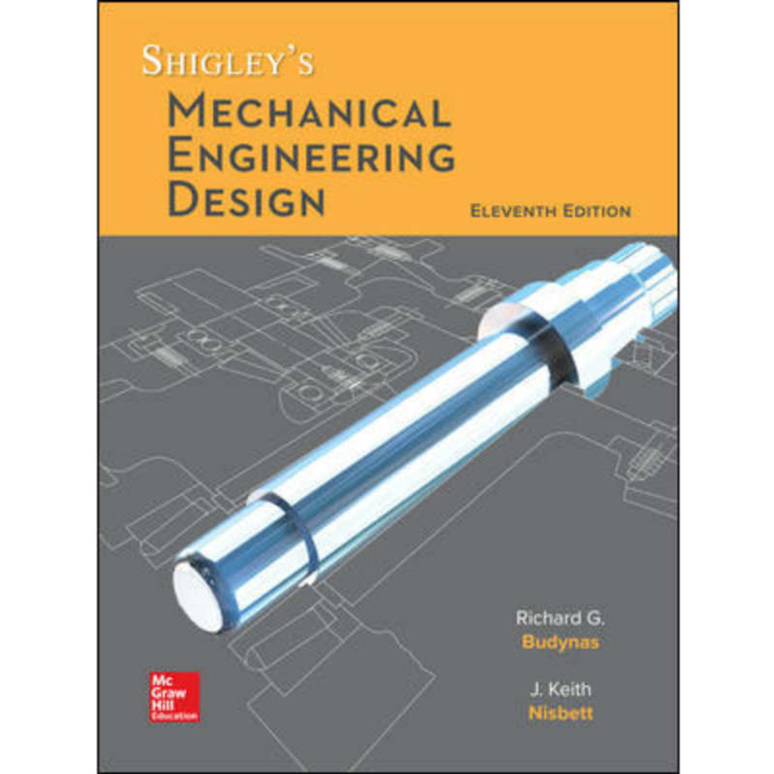
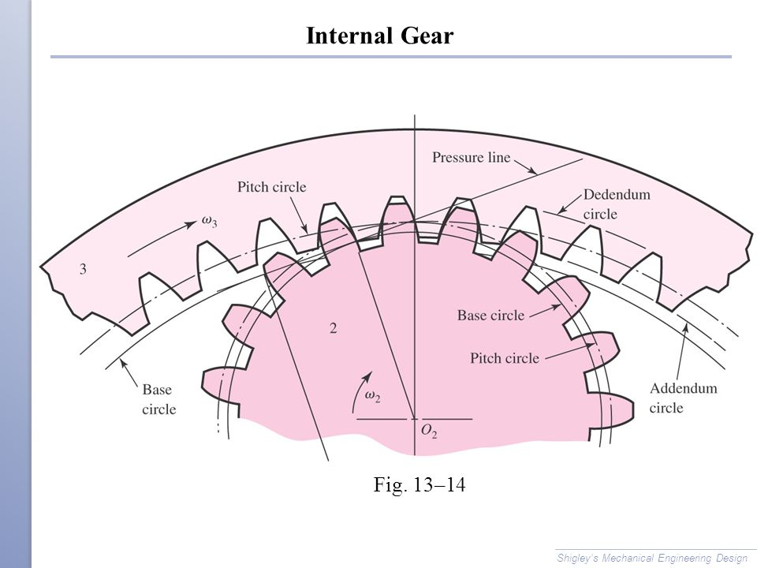
Shigley’s

Slide 11


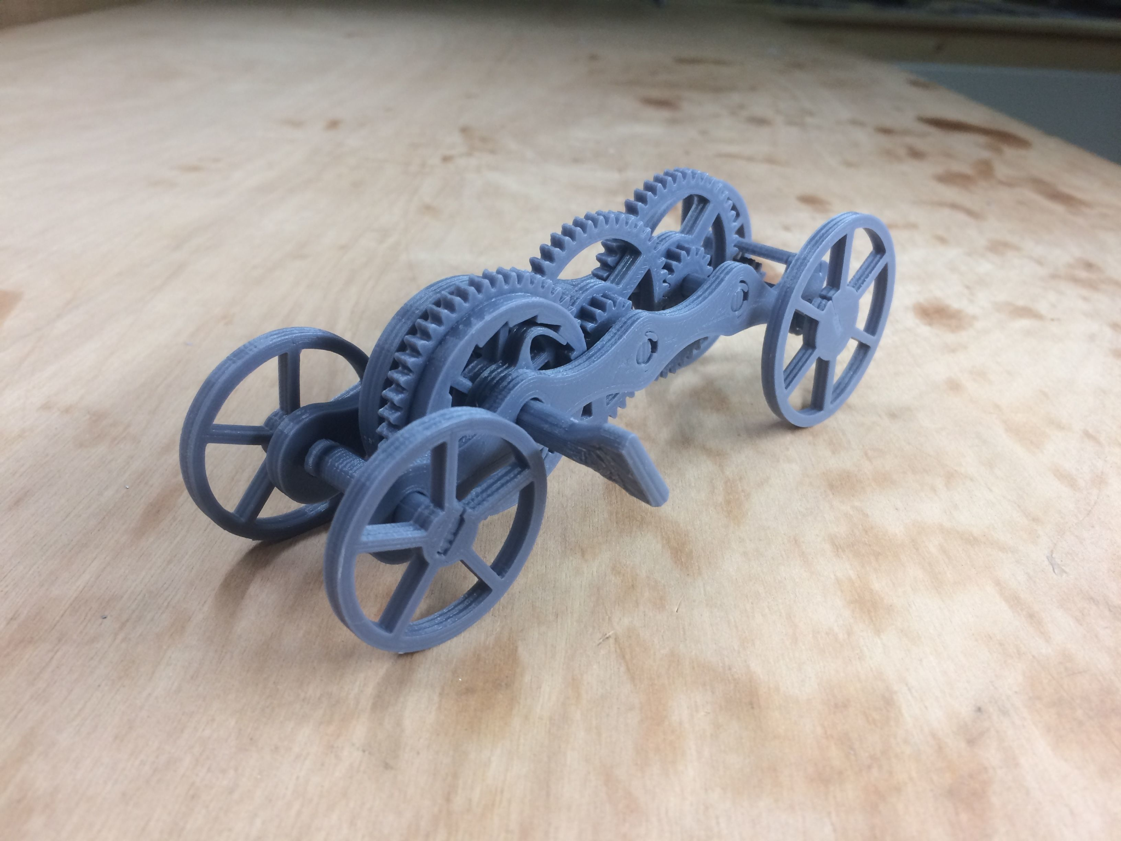
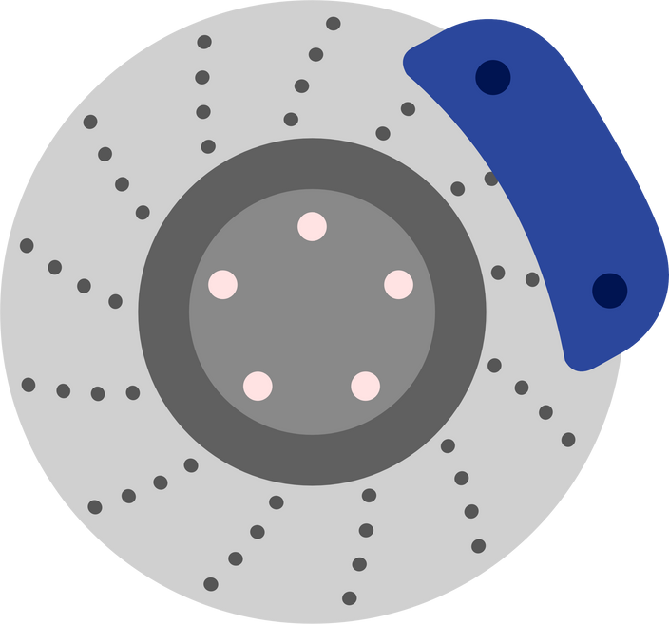
Wind Up Car Instructions

Slide 12
